Slide 1
Short overview preliminary results
Joren Janzing

Slide 2
Content
The 1940s El Niño event: what made it special?
Zonal shelf winds in PACE: is it exceptional?
Melt in MITgcm: can we see a clear response?

Slide 3
What made 1940s El Niño event different?

Slide 4
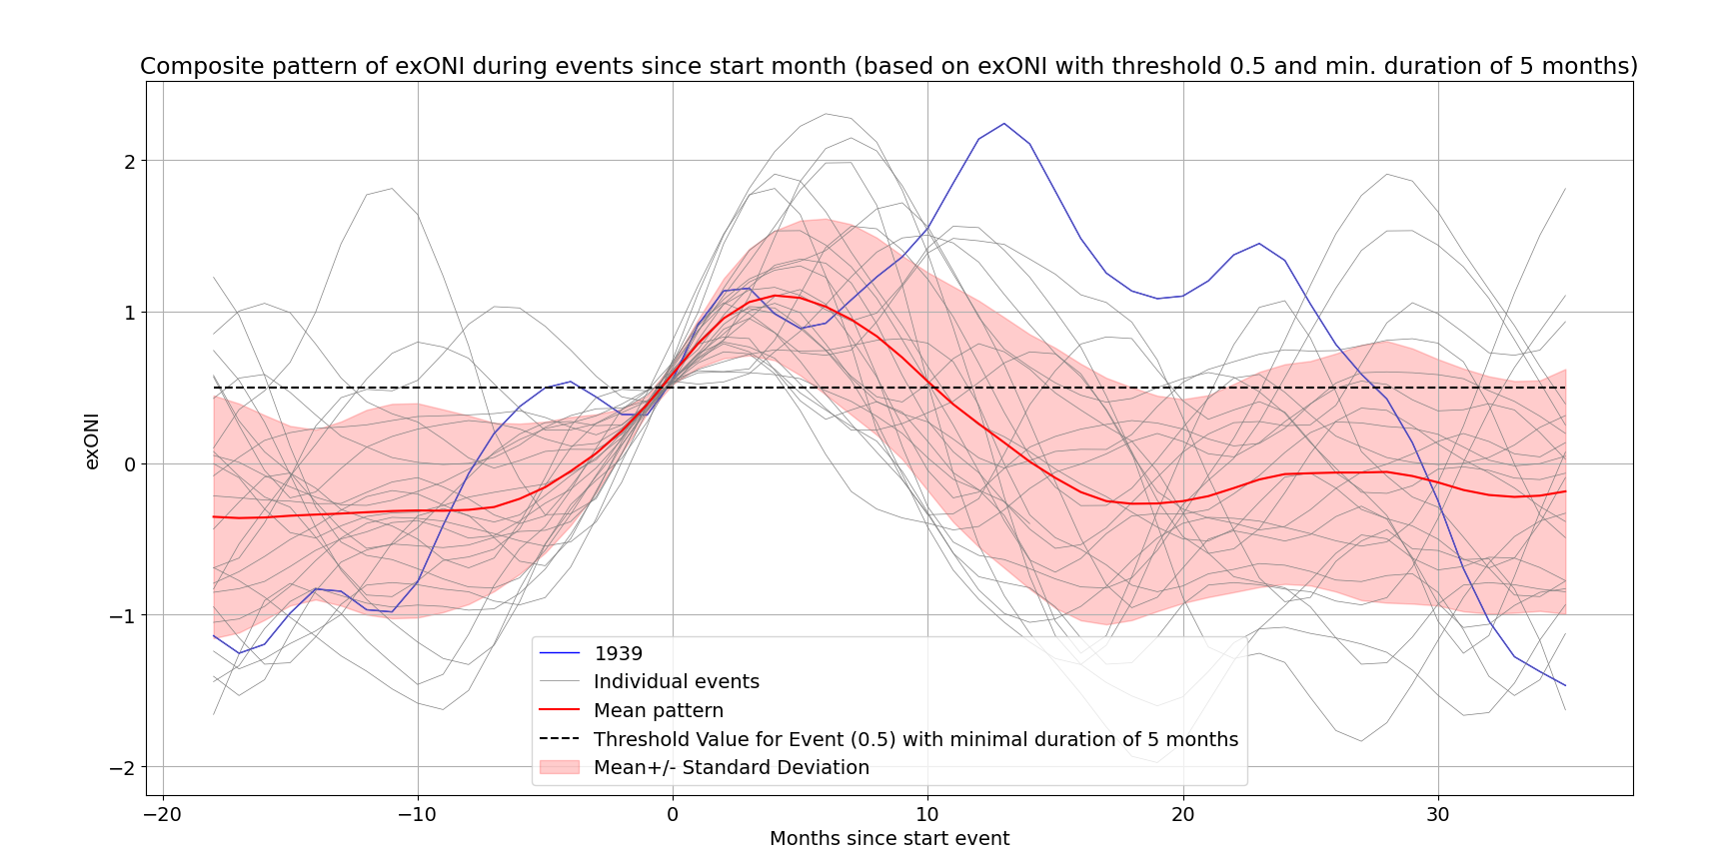
ONI over threshold of 0.5 for a minimal duration of 5 months (NOAA definition).
Time in months since the start of the detection.
Blue line shows the 1940 event.

Slide 5
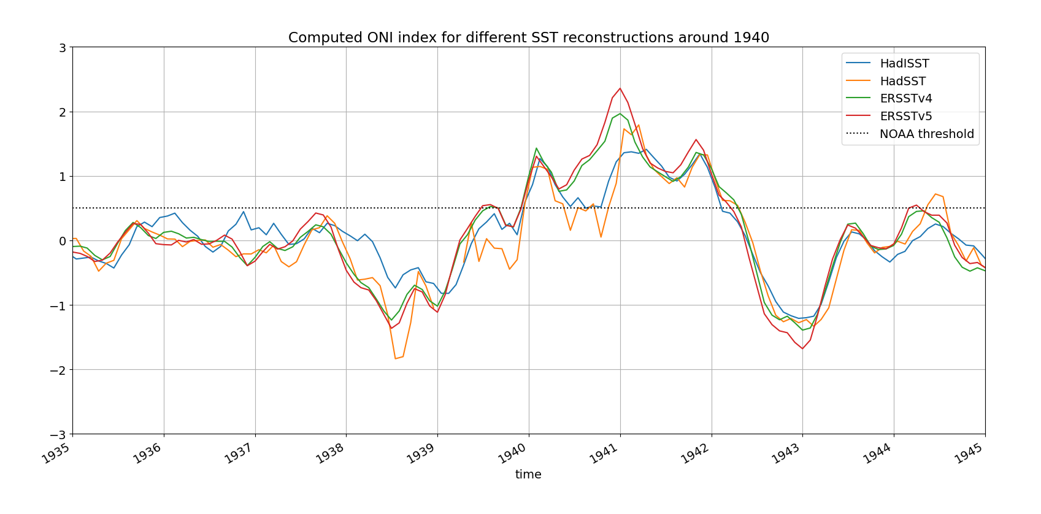
ONI
One event or split into two?
Depends on which SST reconstruction is used

Slide 6
What made the 1940s ENSO event special?
Probably the longest period in the 20th century with El Niño like conditions.
Possibly separated into two events, depending on the reconstruction that you use.
It seems to exist of three phases.

Slide 7
What consensus is there in the PACE ensemble that 1940s winds are exceptional?

Slide 8
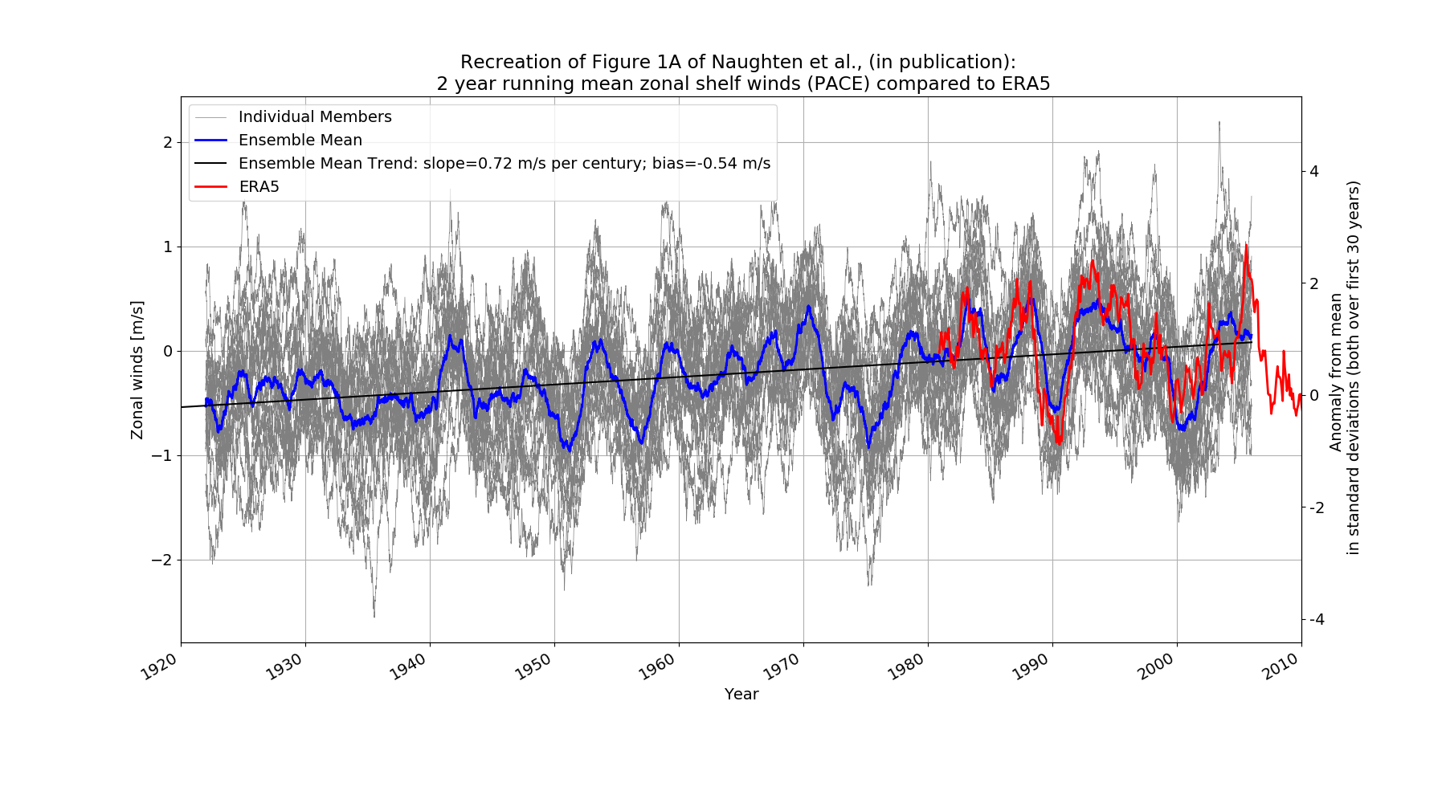
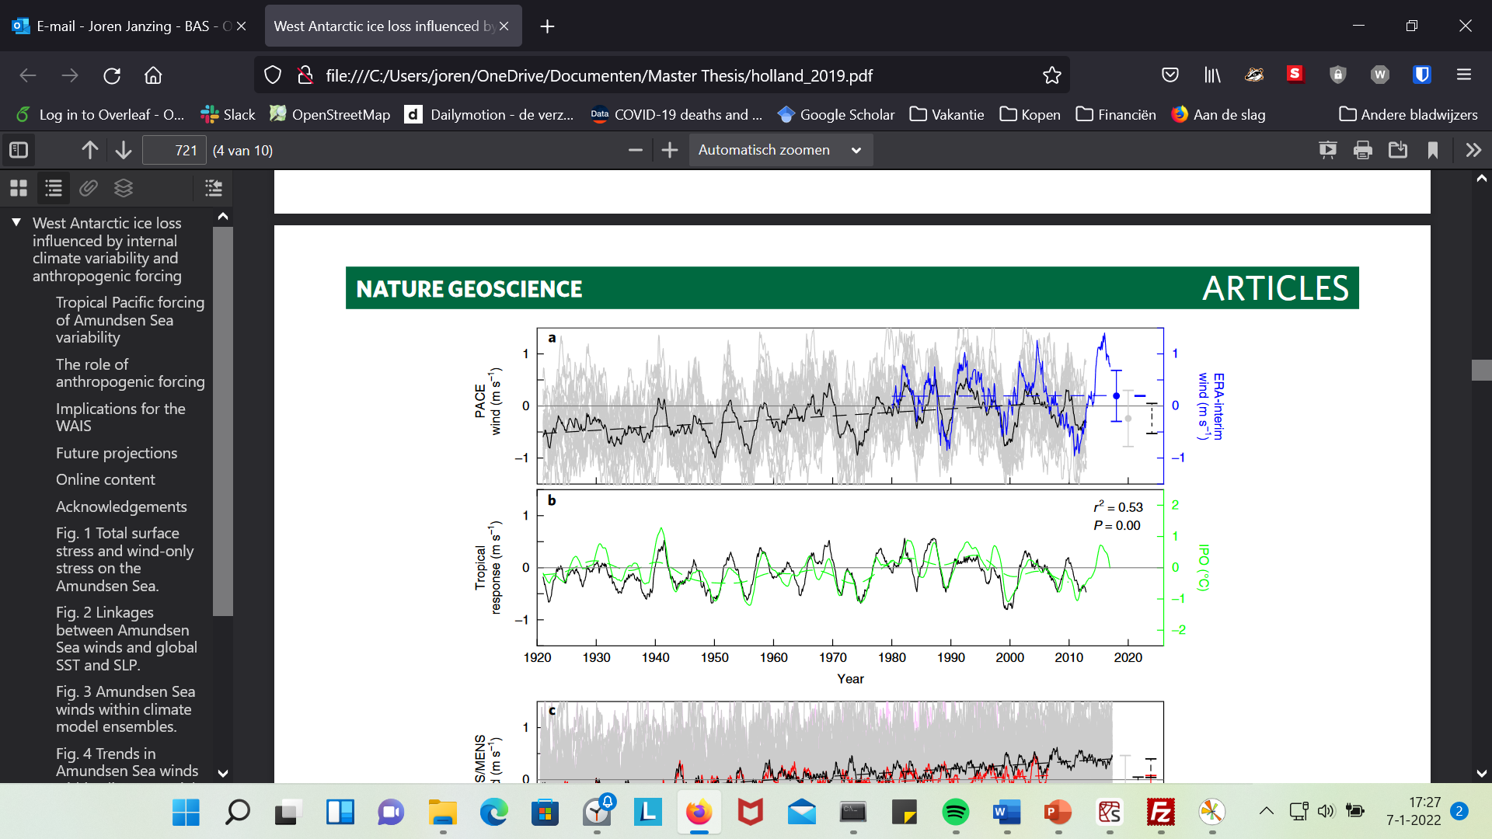
Fig 3A Holland et al., 2019

Slide 9
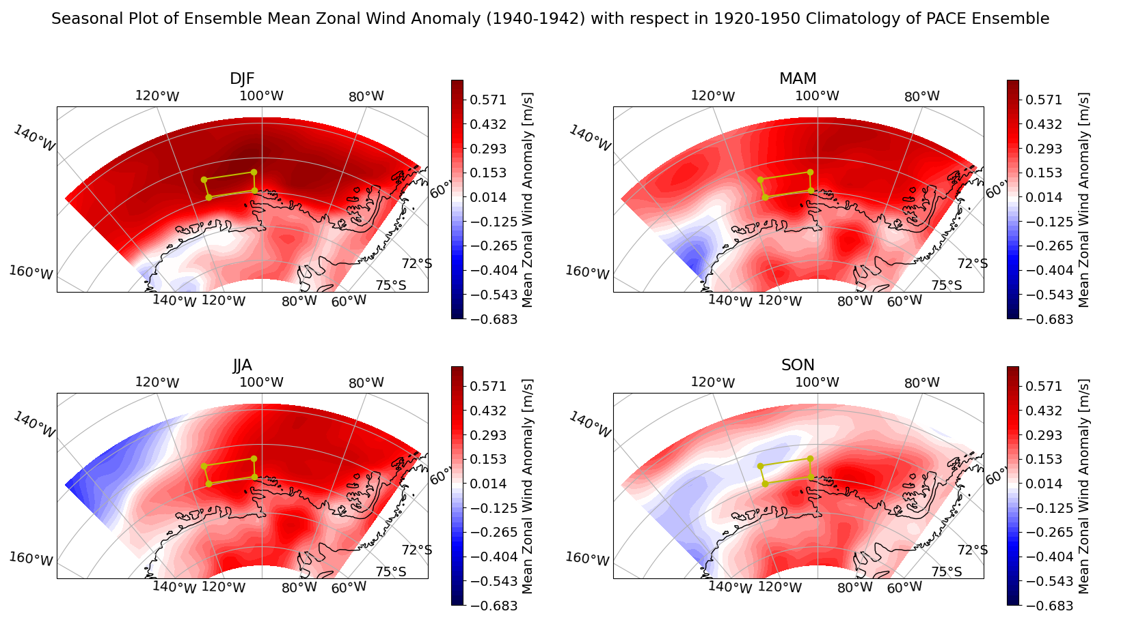

Slide 10
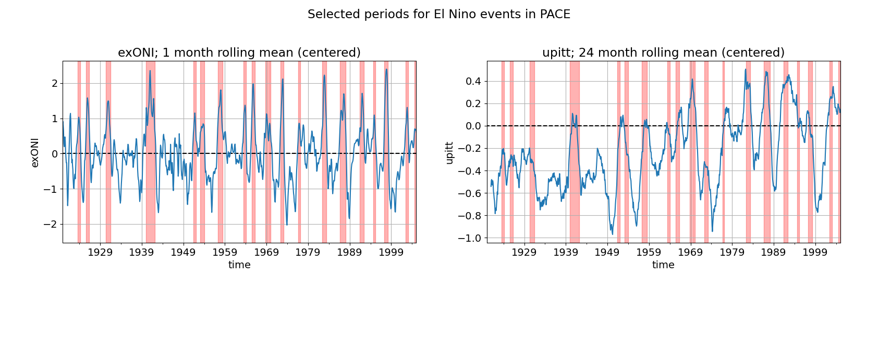

Slide 11
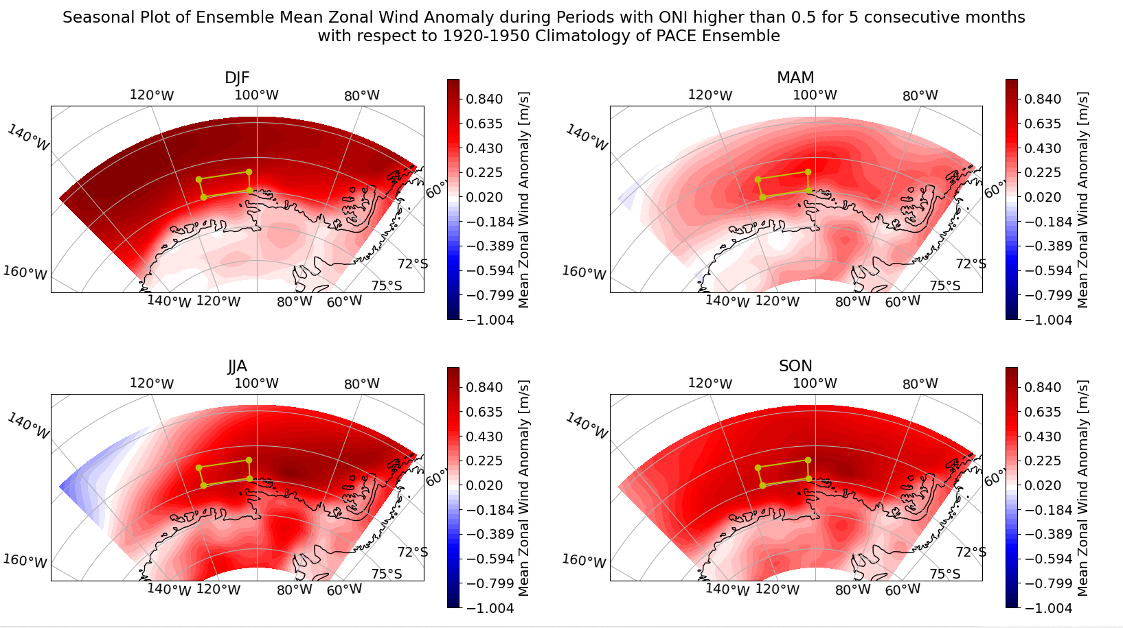

Slide 12
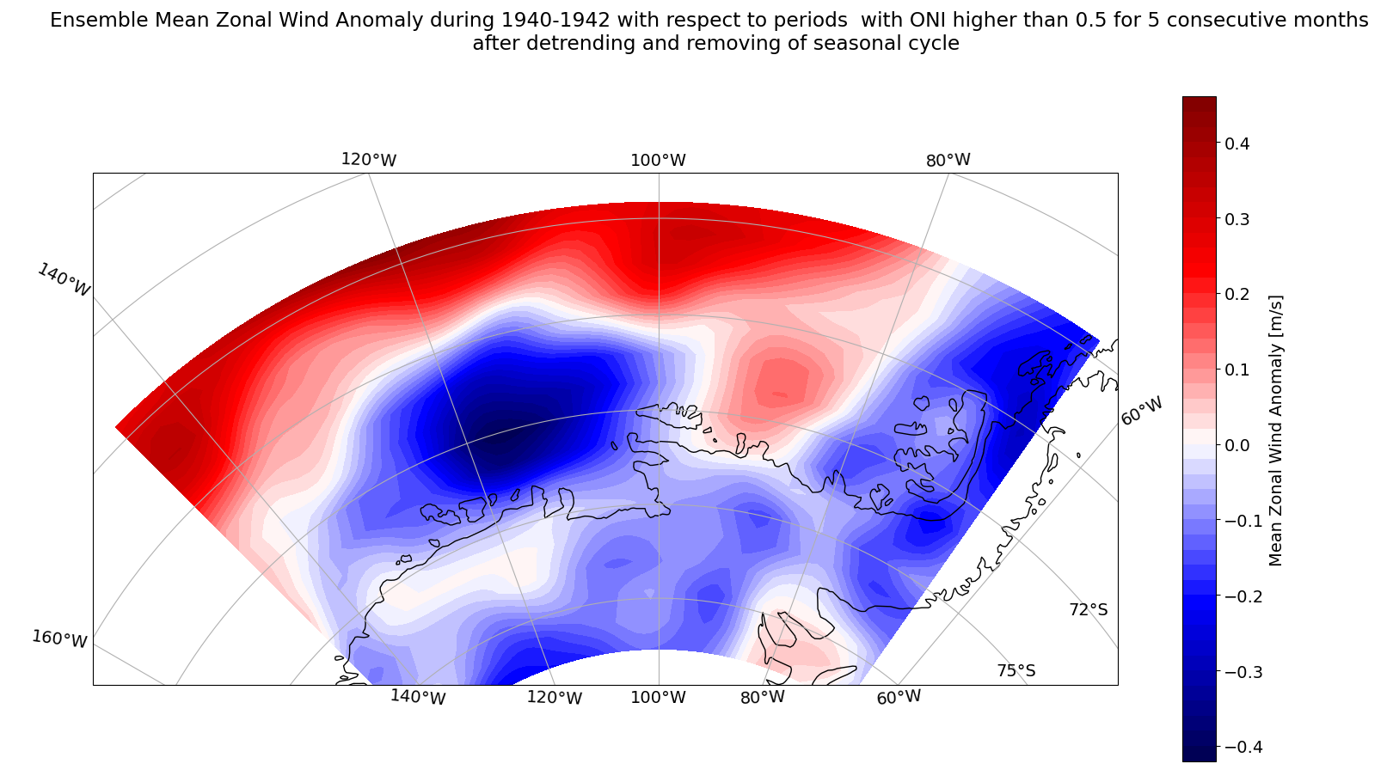

Slide 13
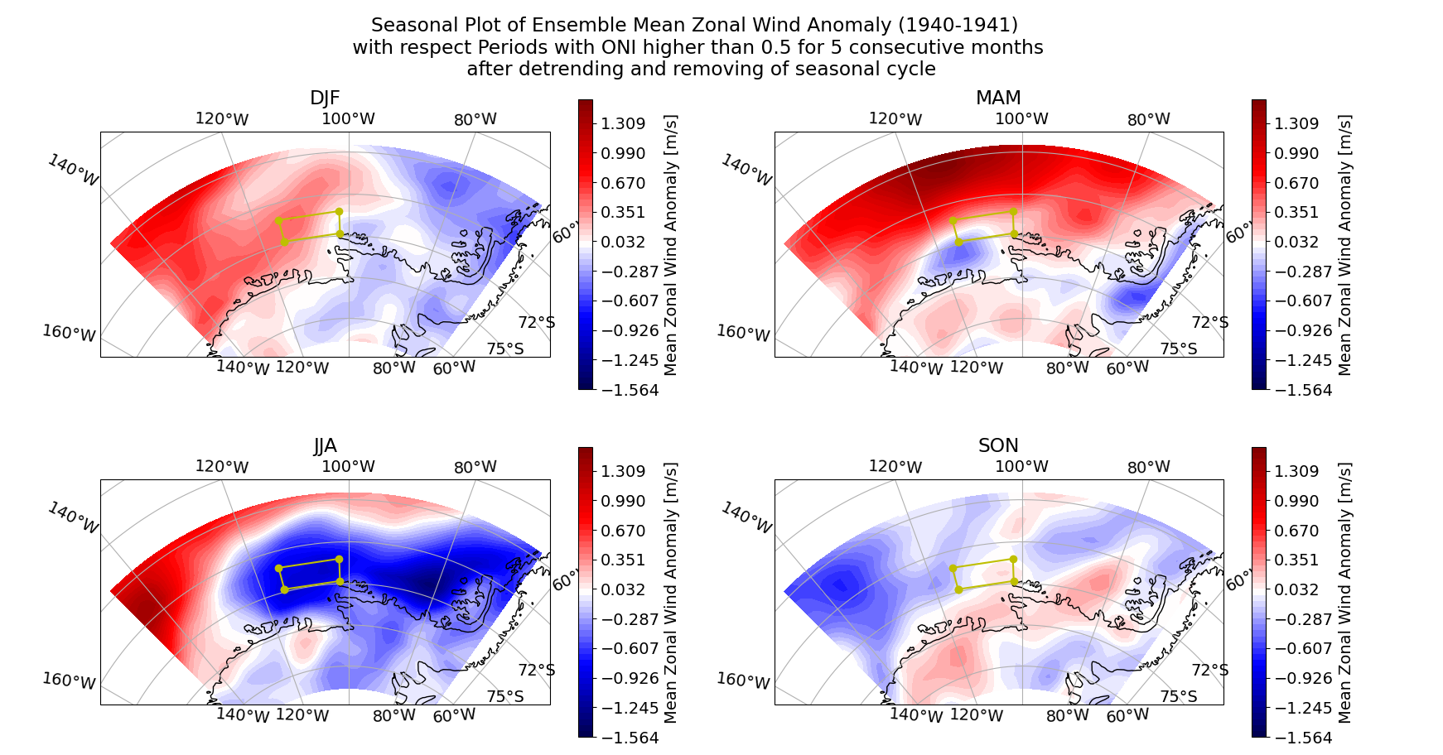

Slide 14
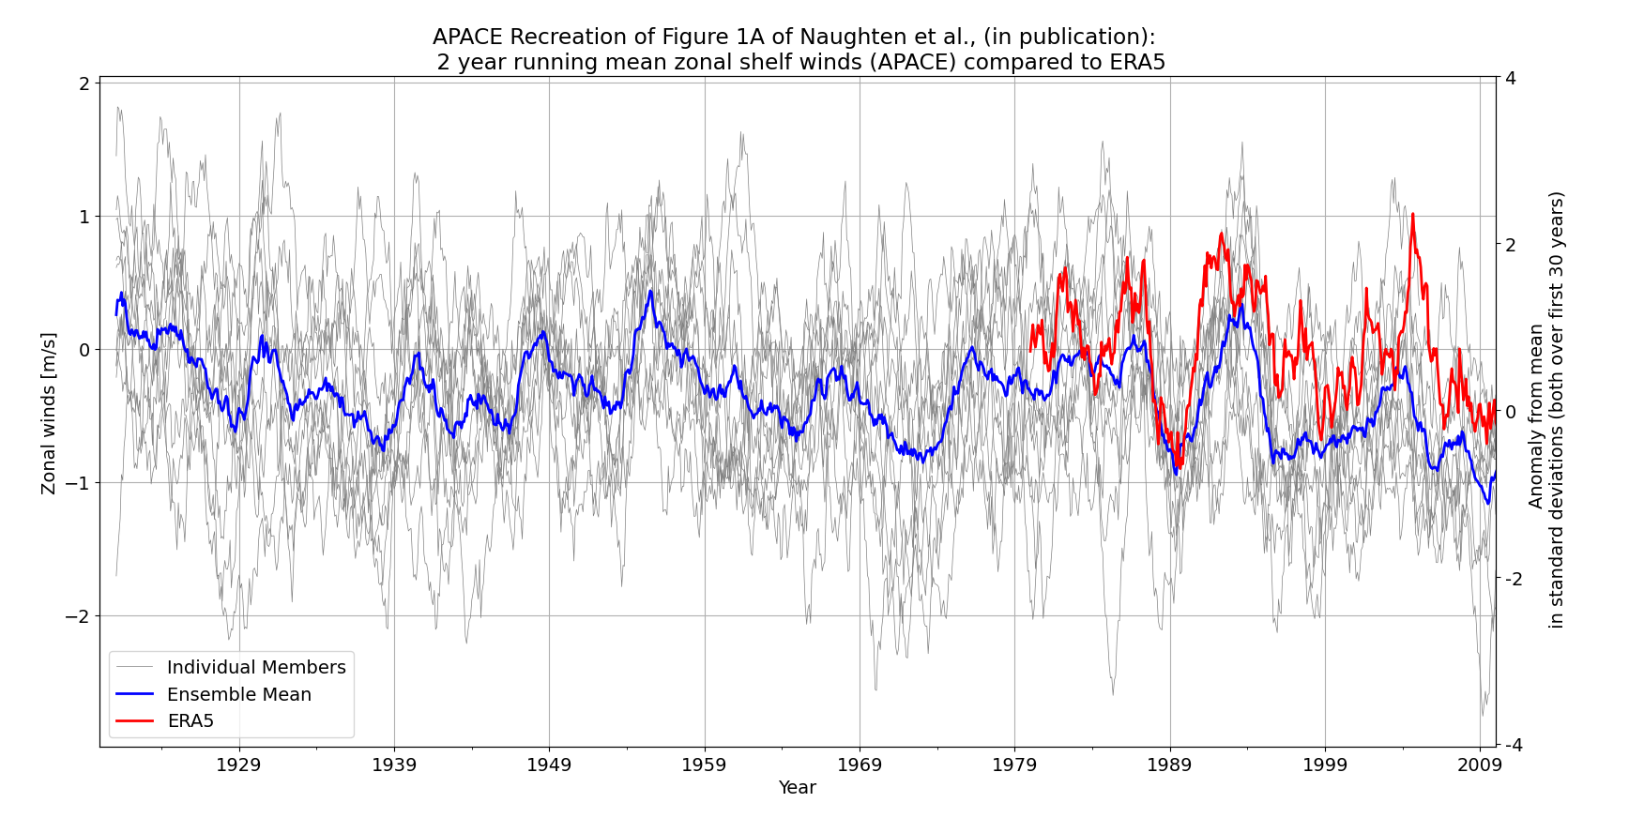

Slide 15
Are the 1940s an exceptional time for zonal shelf winds?
Positive zonal wind anomaly in all seasons over 1939-1942 period
First peak of its kind in the dataset. Could be a threshold?
Not necessarily the strongest anomaly.
ENSO like pattern, but weaker at shelf edge?
Other factors could play a role, which are not in PACE ensemble.

Slide 16
MITgcm
Does the ensemble mean show anything special in the 1940s?
Are there some ensemble members that show a response, and others that don’t (possibly because they are masked by cold convective events?)

Slide 17
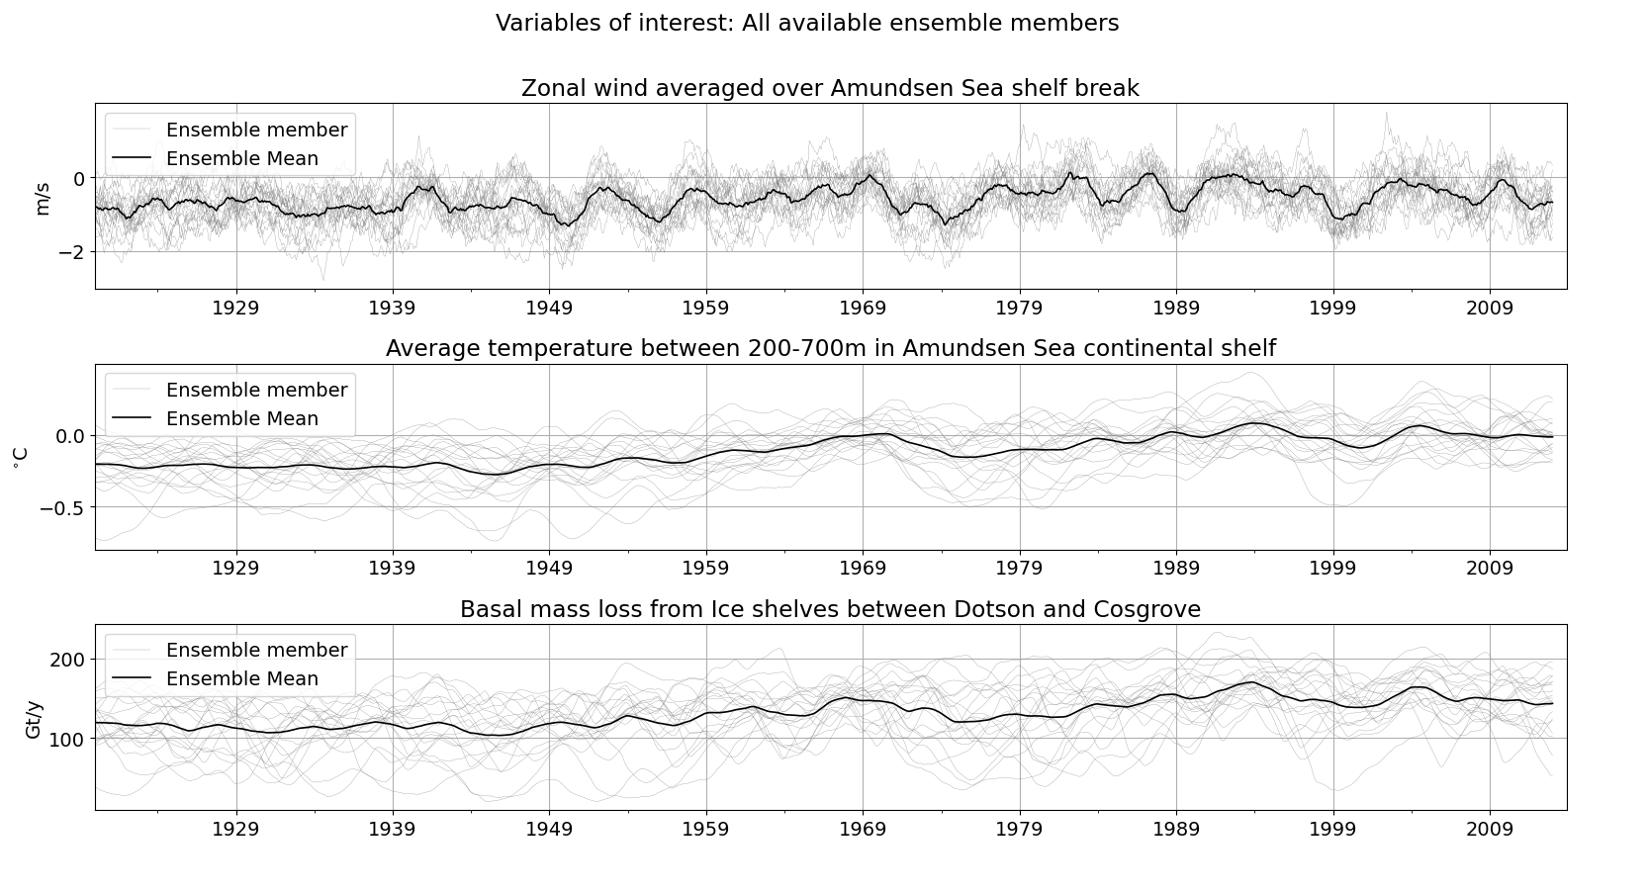
Not much happening in the ensemble mean…

Slide 18
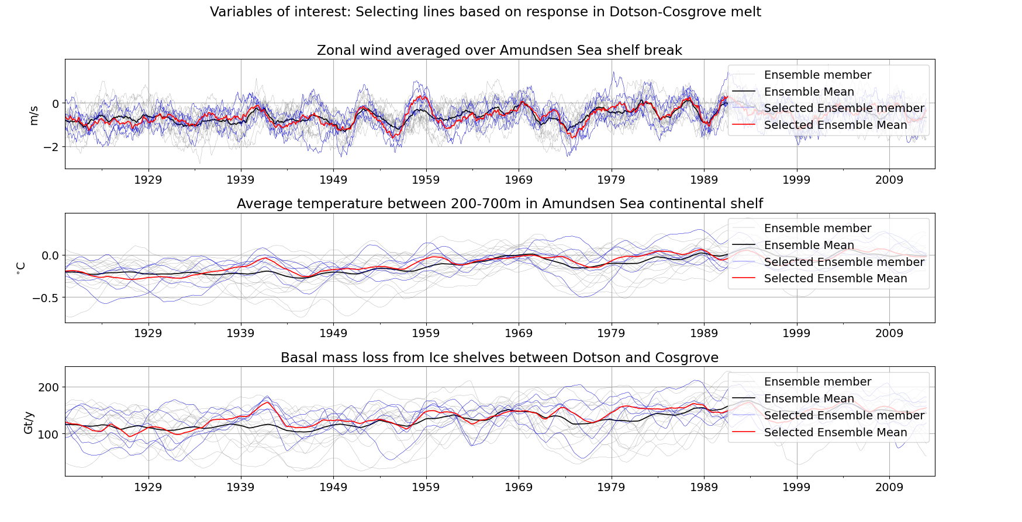
Are there ensemble members that show a strong increase in melting in the 1940s?

Slide 19
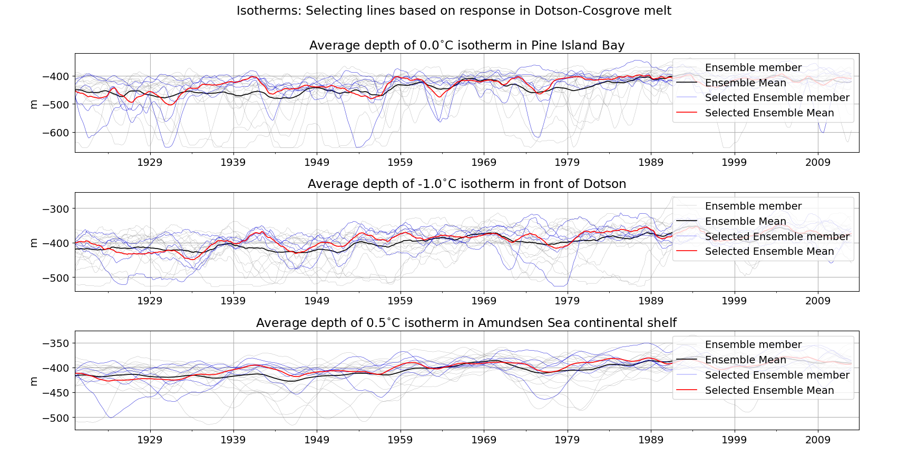
What do they have in common?

Slide 20
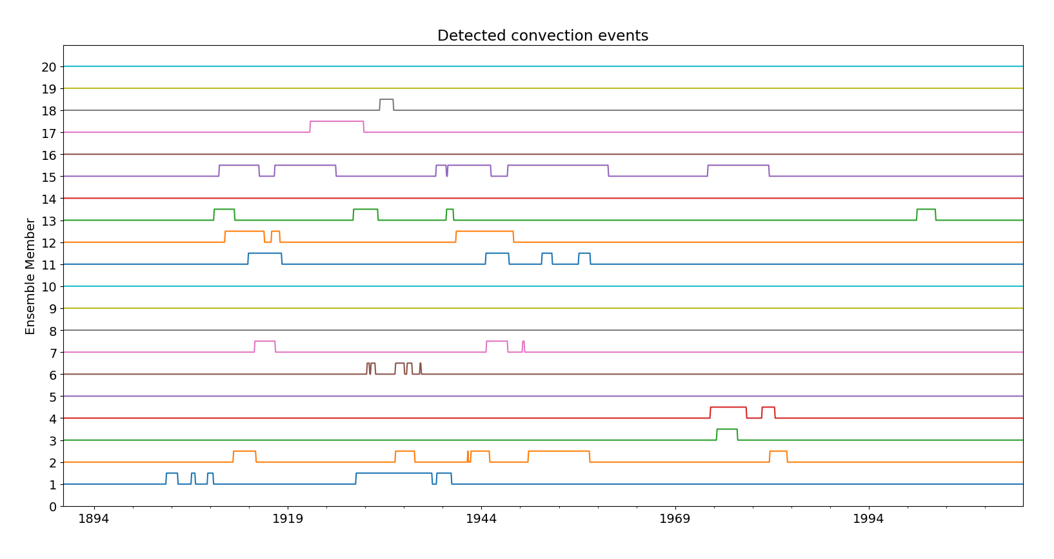
Naughten (concept) Supporting information
Isotherm over Amundsen shelf (0.5 degree C)→ below 440m.
Isotherm on Pine Island Bay (0 degree C )→ below 470m.
Isotherm over in front of Dotson (-1 degree C )→ below 440m.

Slide 21
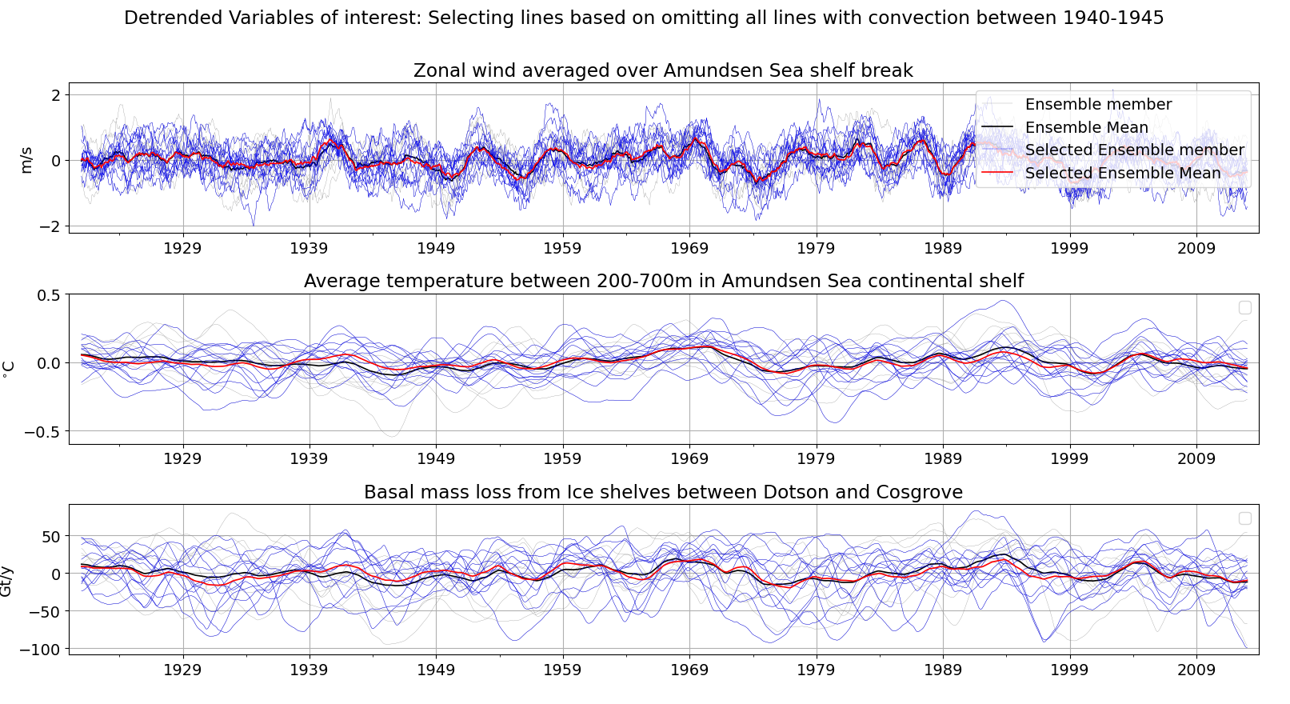
1940s peak: About 11 Gt/y max anomaly

Slide 22
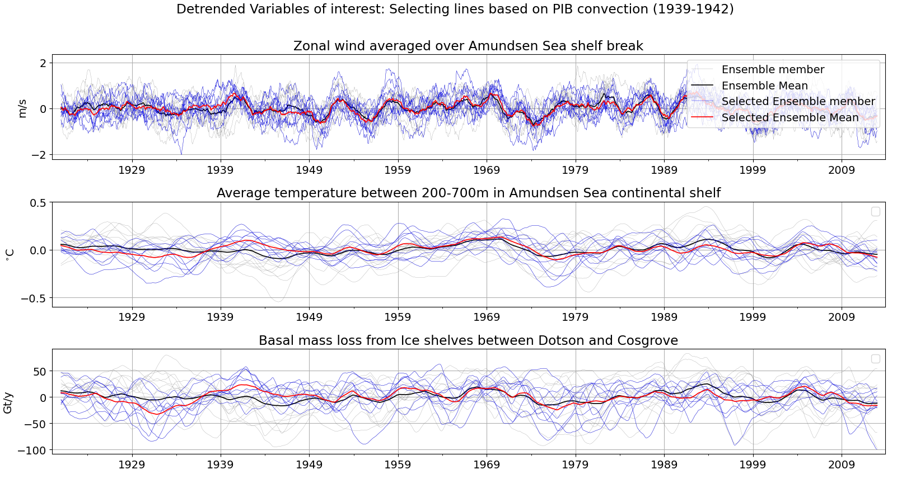
1940s peak: About 23 Gt/y max anomaly

Slide 23
Do the MITgcm runs show an exceptional 1940s event?
Ensemble mean does not show much variation.
Individual members do show melt anomalies.
This seems to be affected by the presence of convection.
Even when removing this, it does not seem to be a very large event.

Slide 24
Extra

Slide 25
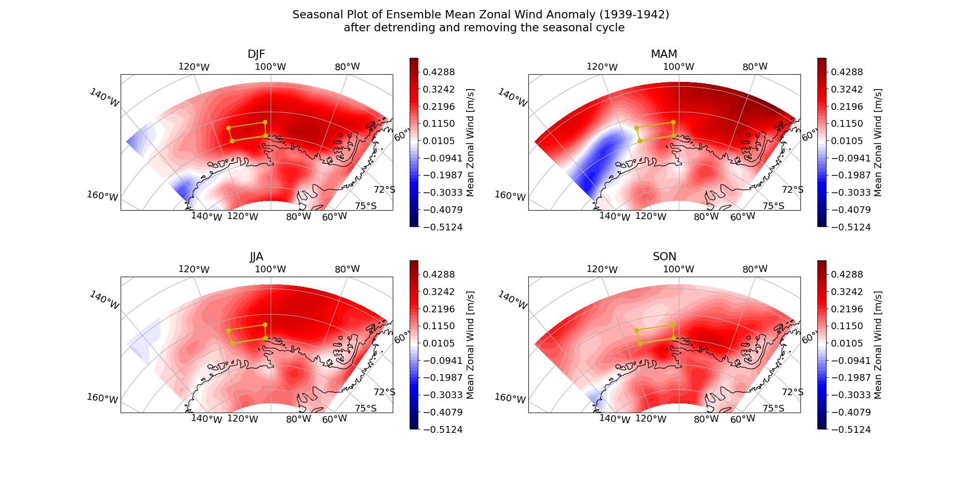

Slide 26
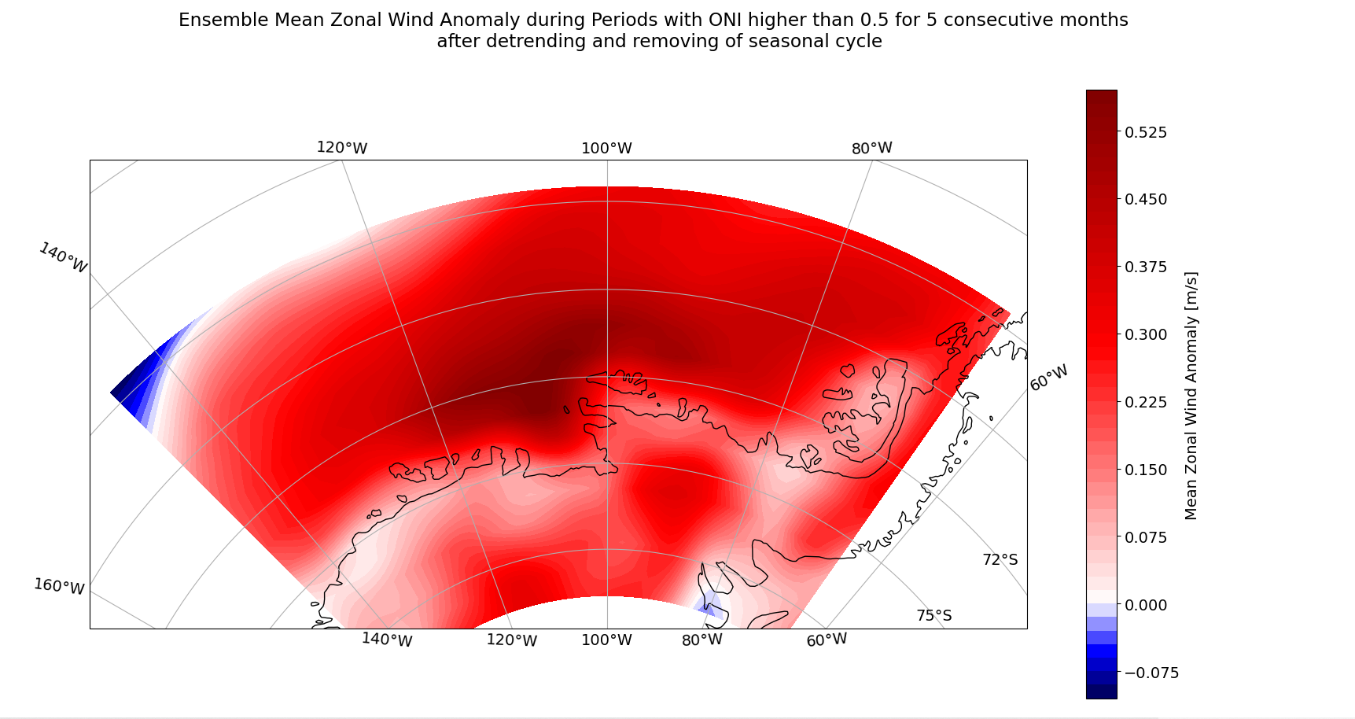

Slide 27
